Slide 1
https://www.vectorlogo.zone/

Slide 2






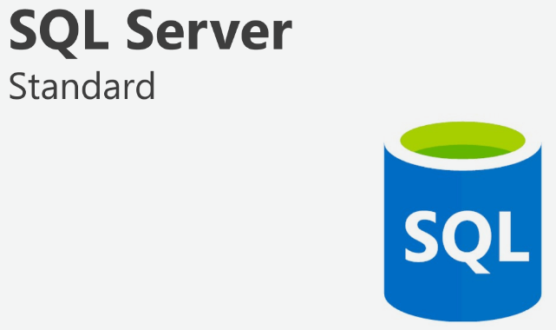

AAA tools
Report
test-cases
AAA-entitlements-automation-job
aaa-ui-testcase
e2e test
aaa-api-testcases
release trigger job
data
aaa-ui-testcases
automation rate
qa-scripts
Team users

Slide 3

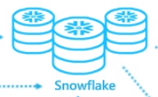

Slide 4
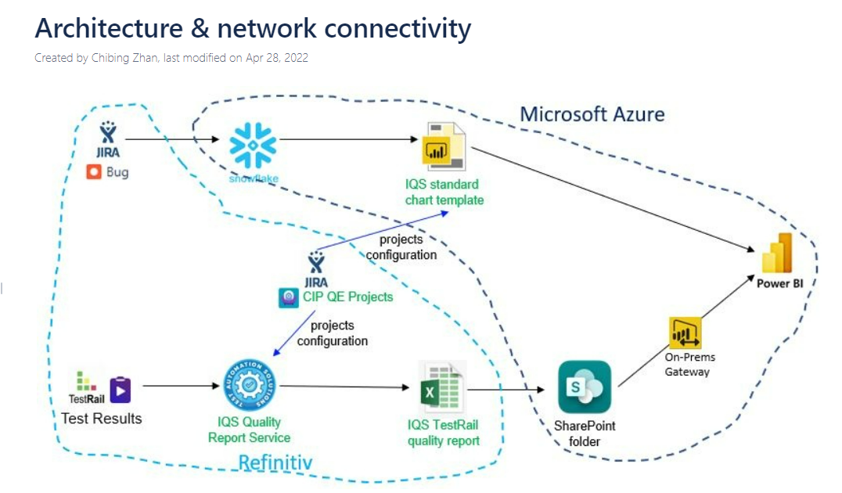

Slide 5
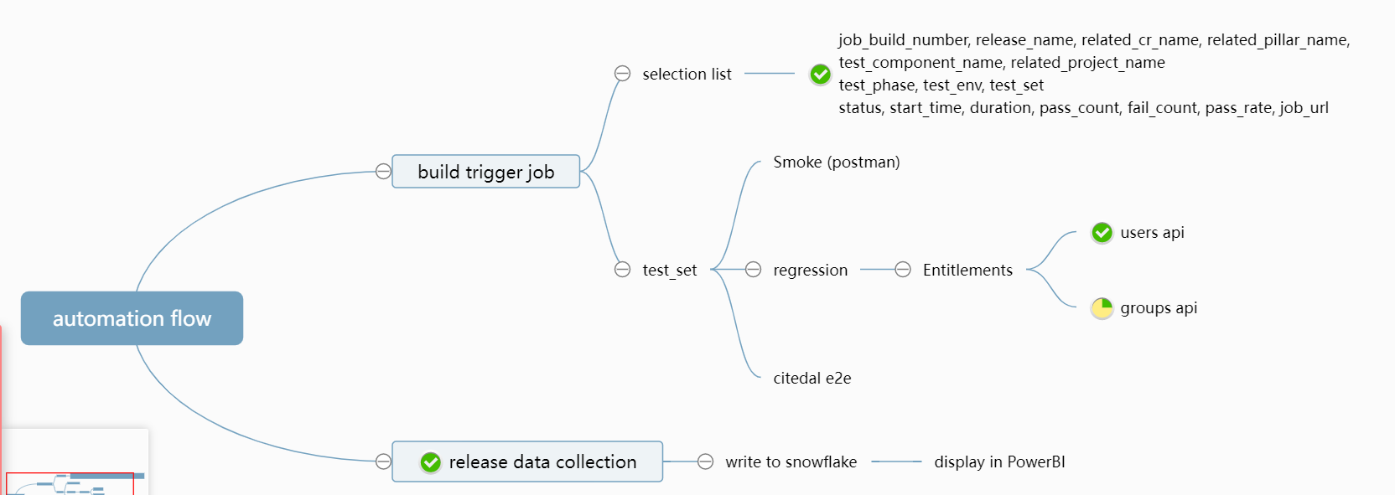

Slide 6

Report
DB
automation jobs
performance jobs
other data

